Slide 1
Credit-Card Fraud Detection via Ensemble Methods and SMOTE
Abe Raouh

Slide 2
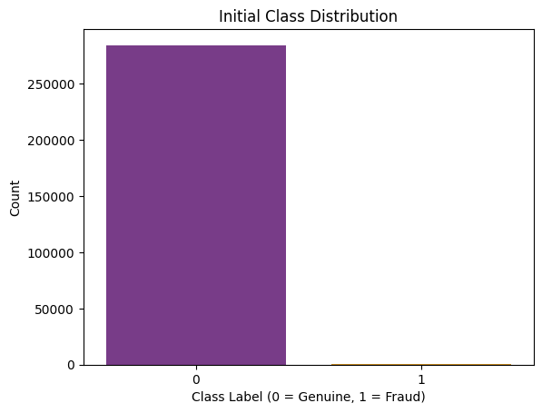
Problem & Data
Why fraud detection matters
$28B annual losses worldwide
Need high recall & high precision
Dataset
284,807 transactions, 0.17 % fraud
28 PCA components (V1–V28), Time, Amount

Slide 3
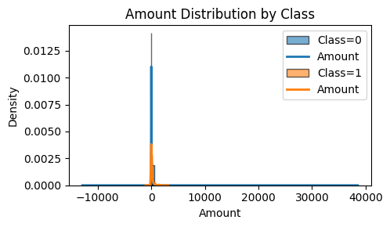
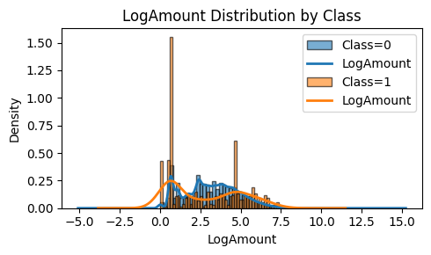
Amount Distributions
Raw Amount: long right tail; fraud enriched in >$2000
Log₁ₚ Amount: compresses tail; reveals fraud spikes at certain log‐levels
Takeaway: Amount alone overlaps heavily between classes

Slide 4
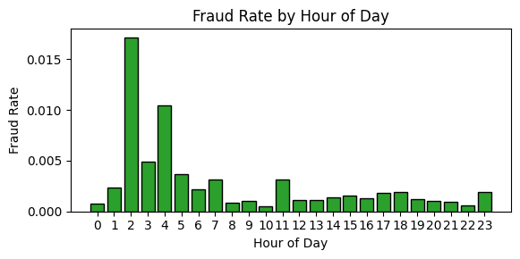
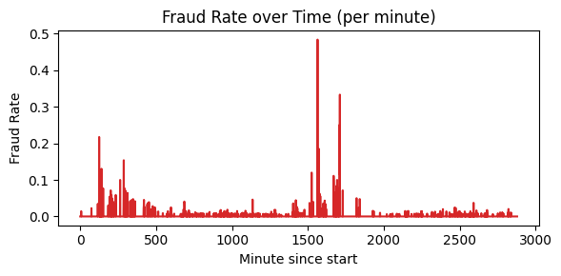
Temporal Patterns
Fraud rate by hour (Fig 3): peaks at 02:00–05:00 (~1.7 %)
Minute‐level bursts (Fig 4): short, high‐spike events
Implication: include temporal features

Slide 5
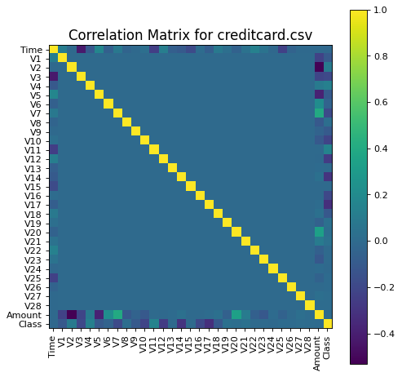
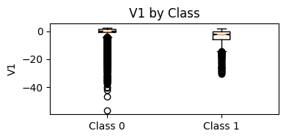
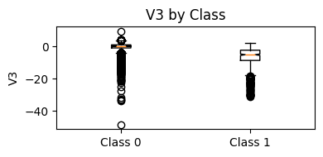
PCA & Outliers
Correlation matrix: V-features nearly orthogonal; only Time–V3 (ρ≈–0.42)
Outlier enrichment:
V3 outliers (1.2 % data) capture 63.4 % of fraud
V1 outliers (2.5 % data) capture 35.4 % of fraud
Boxplots confirm large negative shifts

Slide 6
Methodology
Preprocessing: scale Time & Amount; PCA features pre-scaled
Split: 80/20 stratified train/test
Models (no SMOTE / with SMOTE):
Bagging, Decision Tree, Random Forest, AdaBoost
Metrics: Precision–Recall AUC, F1, confusion matrix

Slide 7
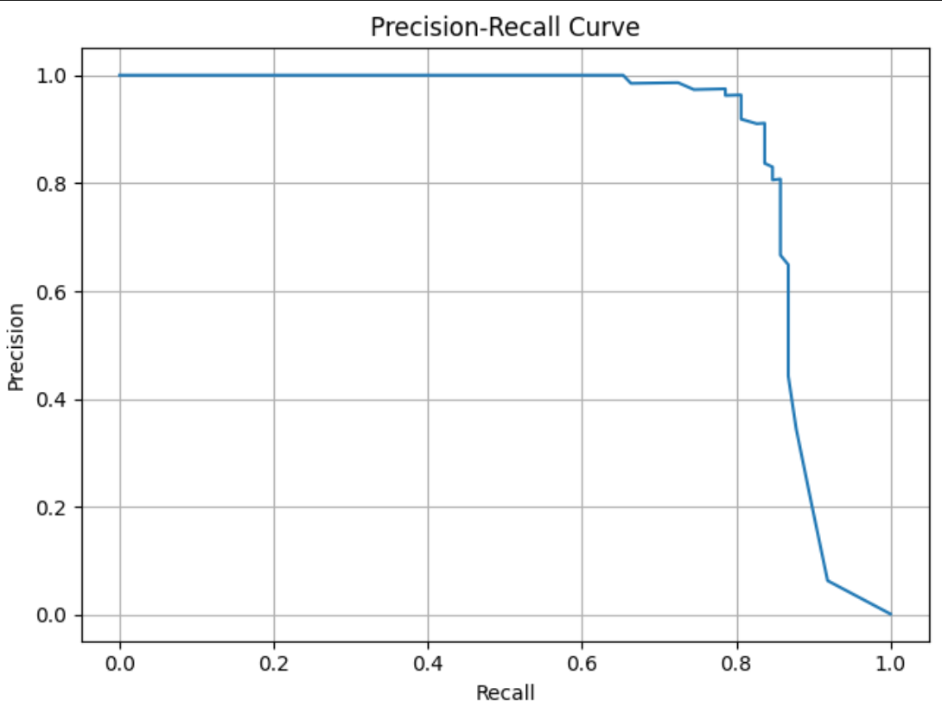
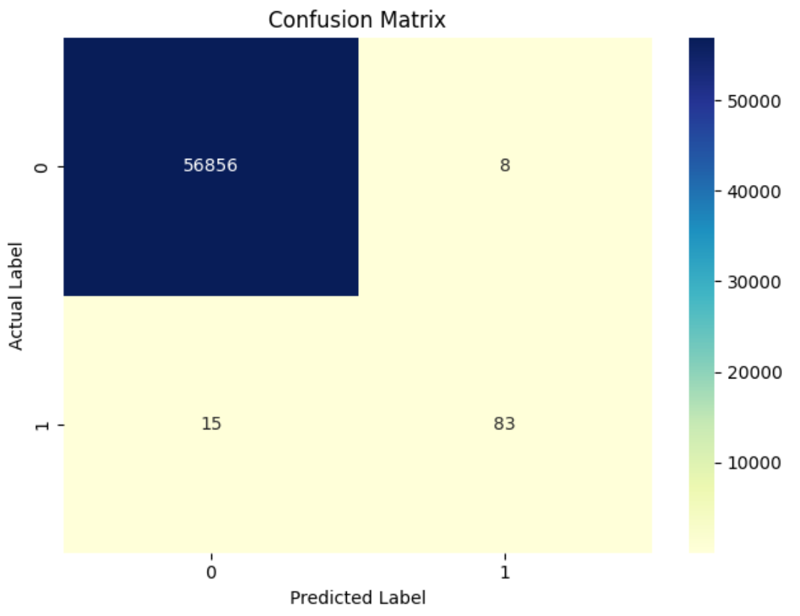
Key Results
Baseline RF: Precision 0.975, Recall 0.786, F1 0.870
RF + SMOTE: Precision 0.912, Recall 0.847, F1 0.878
Other models: large precision drop under SMOTE (e.g. AdaBoost→0.04)

Slide 8
Conclusion and Next Steps
Conclusions:
RandomForest and SMOTE achieves best F1 (0.878)
EDA-driven features (V3, V1, temporal) power detection
Future work:
Engineer hour-of-day dummies, rolling fraud-rate windows
Test ADASYN and anomaly-detection models
Perform threshold tuning / cost‐sensitive learning

Slide 9
Thank you and Q&A
Thank you!
Abe Raouh, abe@raouh.com, iraouh@Fordham.edu
GitHub: https://github.com/ibraouh/credit-card-fraud-ML

